Slide 1
Perceptron Learning

Slide 2
Machine learning models
Some machine learning approaches make strong assumptions about the data
If the assumptions are true it can often lead to better performance
If the assumptions aren’t true, the approach can fail miserably
Linear Regression, Logistic Regression, Naïve Bayes
Other approaches don’t make many assumptions about the data
This can allow us to learn from more varied data
But, they are more prone to overfitting
and generally require more training data
Decision Trees, Random Forest, SVM, Neural Networks

Slide 3
Data generating distribution
We are going to use the probabilistic model of learning
There is some probability distribution over example/label pairs called the data generating distribution
Both the training data and the test set are generated based on this distribution
What is a probability distribution?

Slide 4
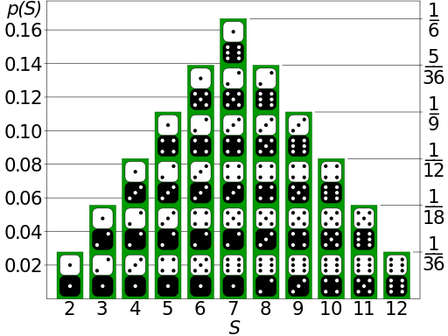
Probability distribution
Describes how likely (i.e. probable) certain events are
Describes probabilities for all possible events
Probabilities are between 0 and 1 (inclusive)
Sum of probabilities over all events is 1

Slide 5

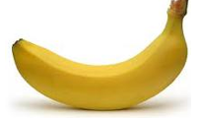
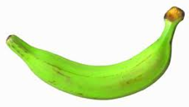
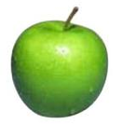
data generating distribution
Training data
Test set
data generating distribution

Slide 6
What is the data generating distribution?

Slide 7
What is the data generating distribution?

Slide 8
What is the data generating distribution?

Slide 9
What is the data generating distribution?

Slide 10
What is the data generating distribution?

Slide 11
What is the data generating distribution?

Slide 12
Actual model

Slide 13
Model assumptions
If you don’t have strong assumptions about the model, it can take you a longer to learn
Assume now that our model of the blue class is two circles

Slide 14
What is the data generating distribution?

Slide 15
What is the data generating distribution?

Slide 16
What is the data generating distribution?

Slide 17
What is the data generating distribution?

Slide 18
What is the data generating distribution?

Slide 19
Actual model

Slide 20
What is the data generating distribution?
Knowing the model beforehand can drastically improve the learning and the number of examples required

Slide 21
What is the data generating distribution?

Slide 22
Make sure your assumption is correct, though!

Slide 23
Machine learning models
What are the model assumptions (if any) that k-NN and decision trees make about the data?
Are there data sets that could never be learned correctly by either?

Slide 24
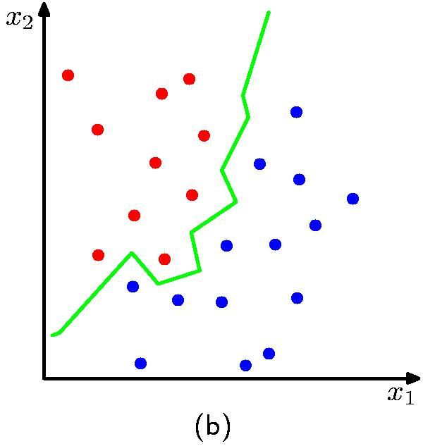
k-NN model
K = 1
No model assumptions. Assumes that proximity relates to class
Notes:
NO model assumptions
does assume that proximity in the feature space relates to class
kNN can learn any arbitrary separation between the classes

Slide 25
Decision tree model
label 1
label 2
label 3
Axis-aligned splits/cuts of the data
Notes:
Assumes the data is separable by axis-aligned splits
Fairly week assumption
many things it can’t learn perfectly

Slide 26
Bias
The “bias” of a model is how strong the model assumptions are.
low-bias classifiers make minimal assumptions about the data (k-NN and DT are generally considered low bias)
high-bias classifiers make strong assumptions about the data

Slide 27
Linear models
A strong high-bias assumption is linear separability:
in 2 dimensions, can separate classes by a line
in higher dimensions, need hyperplanes
A linear model is a model that assumes the data is linearly separable

Slide 28

Hyperplanes
A hyperplane is a line/plane in a high-dimensional space
What defines a line?
What defines a hyperplane?

Slide 29
Defining a line
Any pair of values (w₁,w₂) defines a line through the origin:
f₂
f₁

Slide 30
Defining a line
Any pair of values (w₁,w₂) defines a line through the origin:
f₂
-2
-1
0
1
2
1
0.5
0
-0.5
-1
f₁

Slide 31
Defining a line
Any pair of values (w₁,w₂) defines a line through the origin:
f₂
-2
-1
0
1
2
1
0.5
0
-0.5
-1
f₁

Slide 32
Defining a line
Any pair of values (w₁,w₂) defines a line through the origin:
f₂
(1,2)
w=(1,2)
f₁
We can also view it as the line perpendicular to the weight vector

Slide 33
Classifying with a line
Mathematically, how can we classify points based on a line?
f₂
BLUE
(1,1)
f₁
RED
(1,-1)
w=(1,2)

Slide 34
Classifying with a line
Mathematically, how can we classify points based on a line?
f₂
BLUE
(1,1):
(1,1)
(1,-1):
f₁
RED
(1,-1)
w=(1,2)
The sign indicates which side of the line

Slide 35
Defining a line
Any pair of values (w₁,w₂) defines a line through the origin:
f₂
f₁
How do we move the line off of the origin?

Slide 36
Defining a line
Any pair of values (w₁,w₂) defines a line through the origin:
f₂
-2
-1
0
1
2
f₁

Slide 37
Defining a line
Any pair of values (w₁,w₂) defines a line through the origin:
f₂
Now intersects at -1
-2
-1
0
1
2
0.5
0
-0.5
-1
-1.5
f₁

Slide 38
Linear models
A linear model in n-dimensional space (i.e. n features) is define by n+1 weights:
In two dimensions, a line:
In three dimensions, a plane:
In n-dimensions, a hyperplane
(where b = -a)

Slide 39
Classifying with a linear model
We can classify with a linear model by checking the sign:
Positive example
f₁, f₂, …, f_{n}
classifier
Negative example

Slide 40
Learning a linear model
Geometrically, we know what a linear model represents
Given a linear model (i.e. a set of weights and b) we can classify examples
learn
Training
Data
How do we learn a linear model?
(data with labels)

Slide 41
Positive or negative?
NEGATIVE

Slide 42
Positive or negative?
NEGATIVE

Slide 43
Positive or negative?
POSITIVE

Slide 44
Positive or negative?
NEGATIVE

Slide 45
Positive or negative?
POSITIVE

Slide 46
Positive or negative?
POSITIVE

Slide 47
Positive or negative?
NEGATIVE

Slide 48
Positive or negative?
POSITIVE

Slide 49
A method to the madness
blue = positive
yellow triangles = positive
all others negative
How is this learning setup different than the learning we’ve seen so far?
When might this arise?

Slide 50
Online learning algorithm
0
learn
Labeled data
Only get to see one example at a time!

Slide 51
Online learning algorithm
0
0
learn
Labeled data
Only get to see one example at a time!

Slide 52
Online learning algorithm
0
0
learn
Labeled data
1
Only get to see one example at a time!

Slide 53
Online learning algorithm
0
0
learn
Labeled data
1
1
Only get to see one example at a time!

Slide 54
Online learning algorithm
0
0
learn
Labeled data
1
1
…
Only get to see one example at a time!

Slide 55
Learning a linear classifier
f₂
f₁
What does this model currently say?
w=(1,0)

Slide 56
Learning a linear classifier
f₂
NEGATIVE
f₁
POSITIVE
w=(1,0)

Slide 57
Learning a linear classifier
f₂
(-1,1)
f₁
Is our current guess:
right or wrong?
w=(1,0)

Slide 58
Learning a linear classifier
f₂
(-1,1)
f₁
predicts negative, wrong
Geometrically, how should
we update the model?
w=(1,0)

Slide 59
Learning a linear classifier
f₂
(-1,1)
f₁
Should move this direction
w=(1,0)

Slide 60
A closer look at why we got it wrong
w₁
w₂
(-1, 1, positive)
We’d like this value to be positive since it’s a positive value
Which of the weights contributed to the mistake?

Slide 61
A closer look at why we got it wrong
w₁
w₂
(-1, 1, positive)
We’d like this value to be positive since it’s a positive value
contributed in the wrong direction
could have contributed (positive feature), but didn’t
How should we change the weights?

Slide 62
A closer look at why we got it wrong
w₁
w₂
(-1, 1, positive)
We’d like this value to be positive since it’s a positive value
contributed in the wrong direction
could have contributed (positive feature), but didn’t
decrease
increase
1 -> 0
0 -> 1

Slide 63
Learning a linear classifier
f₂
(-1,1)
f₁
Geometrically, this also makes sense!
w=(0,1)

Slide 64
Learning a linear classifier
f₂
f₁
Is our current guess:
right or wrong?
(1,-1)
w=(0,1)

Slide 65
Learning a linear classifier
f₂
f₁
predicts negative, correct
(1,-1)
How should we update the model?
w=(0,1)

Slide 66
Learning a linear classifier
f₂
f₁
Already correct… don’t change it!
(1,-1)
w=(0,1)

Slide 67
Learning a linear classifier
f₂
f₁
Is our current guess:
right or wrong?
(-1,-1)
w=(0,1)

Slide 68
Learning a linear classifier
f₂
f₁
predicts negative, wrong
(-1,-1)
Geometrically, how should
we update the model?
w=(0,1)

Slide 69
Learning a linear classifier
f₂
Should move this direction
f₁
(-1,-1)
w=(0,1)

Slide 70
A closer look at why we got it wrong
w₁
w₂
(-1, -1, positive)
We’d like this value to be positive since it’s a positive value
Which of the weights contributed to the mistake?

Slide 71
A closer look at why we got it wrong
w₁
w₂
(-1, -1, positive)
We’d like this value to be positive since it’s a positive value
didn’t contribute, but could have
contributed in the wrong direction
How should we change the weights?

Slide 72
A closer look at why we got it wrong
w₁
w₂
(-1, -1, positive)
We’d like this value to be positive since it’s a positive value
didn’t contribute, but could have
contributed in the wrong direction
decrease
decrease
0 -> -1
1 -> 0

Slide 73
Learning a linear classifier
f₂
f₁, f₂, label
-1,-1, positive
-1, 1, positive
1, 1, negative
1,-1, negative
f₁
w=(-1,0)

Slide 74
Perceptron learning algorithm
repeat until convergence (or for some # of iterations):
for each training example (f₁, f₂, …, f_{n}, label):
check if it’s correct based on the current model
if not correct, update all the weights:
if label positive and feature positive:
increase weight (increase weight = predict more positive)
else if label positive and feature negative:
decrease weight (decrease weight = predict more positive)
else if label negative and feature positive:
decrease weight (decrease weight = predict more negative)
else if label negative and feature negative:
increase weight (increase weight = predict more negative)

Slide 75
A trick…
label * f_{i}
if label positive and feature positive:
increase weight (increase weight = predict more positive)
else if label positive and feature negative:
decrease weight (decrease weight = predict more positive)
else if label negative and feature positive:
decrease weight (decrease weight = predict more negative)
else if label negative and negative weight:
increase weight (increase weight = predict more negative)
1*1=1
1*-1=-1
-1*1=-1
-1*-1=1

Slide 76
A trick…
label * f_{i}
if label positive and feature positive:
increase weight (increase weight = predict more positive)
else if label positive and feature negative:
decrease weight (decrease weight = predict more positive)
else if label negative and feature positive:
decrease weight (decrease weight = predict more negative)
else if label negative and negative weight:
increase weight (increase weight = predict more negative)
1*1=1
1*-1=-1
-1*1=-1
-1*-1=1

Slide 77
Perceptron learning algorithm
repeat until convergence (or for some # of iterations):
for each training example (f₁, f₂, …, f_{n}, label):
check if it’s correct based on the current model
if not correct, update all the weights:
for each w_{i}:
w_{i} = w_{i} + f_{i}*label
b = b + label
How do we check if it’s correct?

Slide 78
Perceptron learning algorithm
repeat until convergence (or for some # of iterations):
for each training example (f₁, f₂, …, f_{n}, label):
if prediction * label ≤ 0: // they don’t agree
for each w_{i}:
w_{i} = w_{i} + f_{i}*label
b = b + label

Slide 79
Perceptron learning algorithm
repeat until convergence (or for some # of iterations):
for each training example (f₁, f₂, …, f_{n}, label):
if prediction * label ≤ 0: // they don’t agree
for each w_{i}:
w_{i} = w_{i} + f_{i}*label
b = b + label
Would this work for non-binary features, i.e. real-valued?

Slide 80
Your turn ☺
repeat until convergence (or for some # of iterations):
for each training example (f₁, f₂, …, f_{n}, label):
if prediction * label ≤ 0: // they don’t agree
for each w_{i}:
w_{i} = w_{i} + f_{i}*label
f₂
(-1,1)
(1,1)
4
1
f₁
Repeat until convergence
Keep track of w₁, w₂ as they change
Redraw the line after each step
(-1,-1)
3
2
(.5,-1)
w = (1, 0)

Slide 81
Your turn ☺
repeat until convergence (or for some # of iterations):
for each training example (f₁, f₂, …, f_{n}, label):
if prediction * label ≤ 0: // they don’t agree
for each w_{i}:
w_{i} = w_{i} + f_{i}*label
f₂
(-1,1)
(1,1)
f₁
(-1,-1)
(.5,-1)
w = (0, -1)

Slide 82
Your turn ☺
repeat until convergence (or for some # of iterations):
for each training example (f₁, f₂, …, f_{n}, label):
if prediction * label ≤ 0: // they don’t agree
for each w_{i}:
w_{i} = w_{i} + f_{i}*label
f₂
(-1,1)
(1,1)
f₁
(-1,-1)
(.5,-1)
w = (-1, 0)

Slide 83
Your turn ☺
repeat until convergence (or for some # of iterations):
for each training example (f₁, f₂, …, f_{n}, label):
if prediction * label ≤ 0: // they don’t agree
for each w_{i}:
w_{i} = w_{i} + f_{i}*label
f₂
(-1,1)
(1,1)
f₁
(-1,-1)
(.5,-1)
w = (-.5, -1)

Slide 84
Your turn ☺
repeat until convergence (or for some # of iterations):
for each training example (f₁, f₂, …, f_{n}, label):
if prediction * label ≤ 0: // they don’t agree
for each w_{i}:
w_{i} = w_{i} + f_{i}*label
f₂
(-1,1)
(1,1)
f₁
(-1,-1)
(.5,-1)
w = (-1.5, 0)

Slide 85
Your turn ☺
repeat until convergence (or for some # of iterations):
for each training example (f₁, f₂, …, f_{n}, label):
if prediction * label ≤ 0: // they don’t agree
for each w_{i}:
w_{i} = w_{i} + f_{i}*label
f₂
(-1,1)
(1,1)
f₁
(-1,-1)
(.5,-1)
w = (-1, -1)
Notes:
Why is it important that we count 0 as wrong? Avoids us learning all 0 weights!

Slide 86
Your turn ☺
repeat until convergence (or for some # of iterations):
for each training example (f₁, f₂, …, f_{n}, label):
if prediction * label ≤ 0: // they don’t agree
for each w_{i}:
w_{i} = w_{i} + f_{i}*label
f₂
(-1,1)
(1,1)
f₁
(-1,-1)
(.5,-1)
w = (-2, 0)

Slide 87
Your turn ☺
repeat until convergence (or for some # of iterations):
for each training example (f₁, f₂, …, f_{n}, label):
if prediction * label ≤ 0: // they don’t agree
for each w_{i}:
w_{i} = w_{i} + f_{i}*label
f₂
(-1,1)
(1,1)
f₁
(-1,-1)
(.5,-1)
w = (-1.5, -1)

Slide 88
Which line will it find?

Slide 89
Which line will it find?
Only guaranteed to find some line that separates the data

Slide 90
Convergence
repeat until convergence (or for some # of iterations):
for each training example (f₁, f₂, …, f_{n}, label):
if prediction * label ≤ 0: // they don’t agree
for each w_{i}:
w_{i} = w_{i} + f_{i}*label
b = b + label
Why do we also have the “some # iterations” check?

Slide 91
Handling non-separable data
If we ran the algorithm on this it would never converge!

Slide 92
Convergence
repeat until convergence (or for some # of iterations):
for each training example (f₁, f₂, …, f_{n}, label):
if prediction * label ≤ 0: // they don’t agree
for each w_{i}:
w_{i} = w_{i} + f_{i}*label
b = b + label
Also helps avoid overfitting!
(This is harder to see in 2-D examples, though)

Slide 93
Ordering
repeat until convergence (or for some # of iterations):
for each training example (f₁, f₂, …, f_{n}, label):
if prediction * label ≤ 0: // they don’t agree
for each w_{i}:
w_{i} = w_{i} + f_{i}*label
b = b + label
What order should we traverse the examples?
Does it matter?

Slide 94
Order matters
What would be a good/bad order?

Slide 95
Order matters: a bad order

Slide 96
Order matters: a bad order

Slide 97
Order matters: a bad order

Slide 98
Order matters: a bad order

Slide 99
Order matters: a bad order

Slide 100
Order matters: a bad order

Slide 101
Order matters: a bad order
Solution?

Slide 102
Ordering
repeat until convergence (or for some # of iterations):
randomize order of training examples
for each training example (f₁, f₂, …, f_{n}, label):
if prediction * label ≤ 0: // they don’t agree
for each w_{i}:
w_{i} = w_{i} + f_{i}*label
b = b + label

Slide 103
Improvements
(-1,1)
w = (-1, 0)
What will happen when we examine this example?

Slide 104
Improvements
(-1,1)
w = (0, -1)
Does this make sense? What if we had previously gone through ALL of the other examples correctly?

Slide 105
Improvements
Maybe just move it slightly in the direction of correction

Slide 106
Voted perceptron learning
Training
every time a mistake is made on an example:
store the weights (i.e. before changing for current example)
store the number of examples that set of weights got correct
Classify
calculate the prediction from ALL saved weights
multiply each prediction by the number it got correct (i.e., a weighted vote) and take the sum over all predictions
said another way: pick whichever prediction has the most votes

Slide 107
Voted perceptron learning
Vote
3
1
Training
every time a mistake is made on an example:
store the weights
store the number of examples that set of weights got correct
5
1

Slide 108
Voted perceptron learning
Vote
3
1
Classify
5
1

Slide 109
Voted perceptron learning
Vote
Prediction
3
NEGATIVE
1
POSITIVE
Classify
Decision?
5
NEGATIVE
1
POSITIVE

Slide 110
Voted perceptron learning
Vote
Prediction
3
NEGATIVE
1
POSITIVE
Classify
8: negative
2: positive
5
NEGATIVE
NEGATIVE
1
POSITIVE

Slide 111
Voted perceptron learning
Works much better in practice
Avoids overfitting, though it can still happen
Avoids big changes in the result by examples examined at the end of training

Slide 112
Voted perceptron learning
Training
every time a mistake is made on an example:
store the weights (i.e. before changing for current example)
store the number of examples that set of weights got correct
Classify
calculate the prediction from ALL saved weights
multiply each prediction by the number it got correct (i.e a weighted vote) and take the sum over all predictions
said another way: pick whichever prediction has the most votes
Any issues/concerns?

Slide 113
Voted perceptron learning
Training
every time a mistake is made on an example:
store the weights (i.e. before changing for current example)
store the number of examples that set of weights got correct
Classify
calculate the prediction from ALL saved weights
multiply each prediction by the number it got correct (i.e a weighted vote) and take the sum over all predictions
said another way: pick whichever prediction has the most votes
Can require a lot of storage
Classifying becomes very, very expensive

Slide 114
Average perceptron
Vote
3
1
5
The final weights are the weighted average of the previous weights
1
How does this help us?
Notes:
- these weights

Slide 115
Average perceptron
Vote
3
1
5
The final weights are the weighted average of the previous weights
1
Can just keep a running average!
Notes:
- these weights

Slide 116
Perceptron learning algorithm
repeat until convergence (or for some # of iterations):
for each training example (f₁, f₂, …, f_{n}, label):
if prediction * label ≤ 0: // they don’t agree
for each w_{i}:
w_{i} = w_{i} + f_{i}*label
b = b + label
Why is it called the “perceptron” learning algorithm if what it learns is a line? Why not “line learning” algorithm?

Slide 117
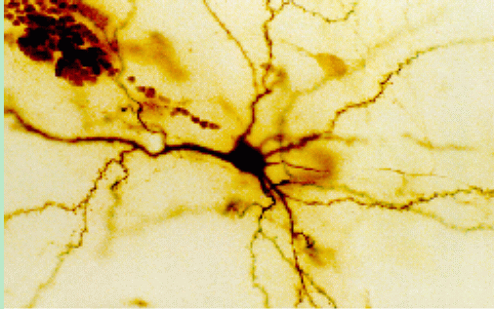
Our Nervous System
Neuron

Slide 118
Our nervous system: the computer science view
the human brain is a large collection of interconnected neurons
a NEURON is a brain cell
collect, process, and disseminate electrical signals
Neurons are connected via synapses
They FIRE depending on the conditions of the neighboring neurons

Slide 119
Node A
Weight w
Node B
(neuron)
(neuron)
w is the strength of signal sent between A and B.
If A fires and w is positive, then A stimulates B.
If A fires and w is negative, then A inhibits B.
If a node is stimulated enough, then it also fires.
How much stimulation is required is determined by its threshold.

Slide 120
Neural Networks
Node (Neuron)
Edge (synapses)

Slide 121
A Single Neuron/Perceptron
Input x₁
Weight w₁
Weight w₂
Input x₂
Output y
threshold function
Input x₃
Weight w₃
Weight w₄
Input x₄

Slide 122
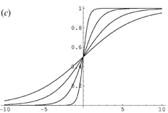
Possible threshold functions
hard threshold:
if in (the sum of weights) >= threshold 1 else 0 otherwise
Sigmoid

Slide 123
A Single Neuron/Perceptron
1
1
1
-1
?
0
1
Threshold of 1
0.5
1

Slide 124
A Single Neuron/Perceptron
1
1
1
-1
0
Weighted sum is 0.5, which is not equal or larger than the threshold
0
1
Threshold of 1
0.5
1

Slide 125
A Single Neuron/Perceptron
1
1
0
-1
?
0
1
Threshold of 1
0.5
1

Slide 126
A Single Neuron/Perceptron
1
1
0
-1
1
Weighted sum is 1.5, which is larger than the threshold
0
1
Threshold of 1
0.5
1

Slide 127
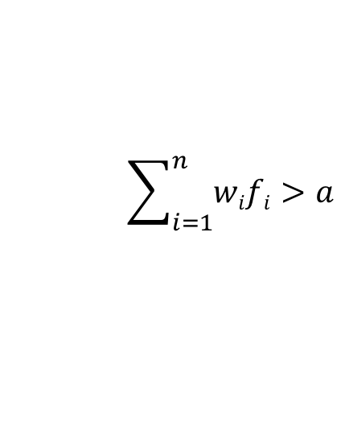
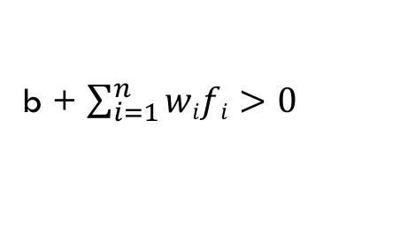
A Single Neuron/Perceptron
1
1
$$\sum_{i=1}^{n}{wifi>a}$$
0
-1
b + $\sum_{i=1}^{n}{wifi>0}$
0
1
where b = -a
Threshold of 1
0.5
1

